Slide 1
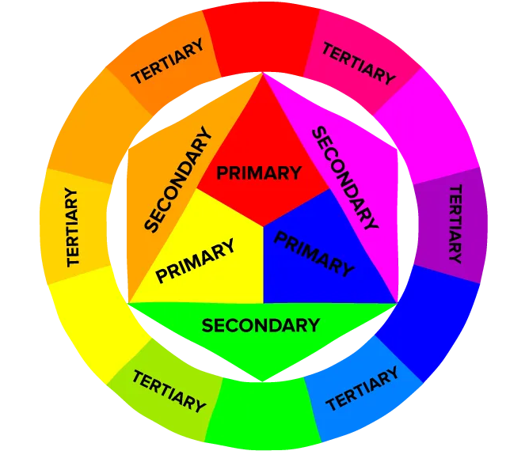
Data Sources & Methods

Slide 2
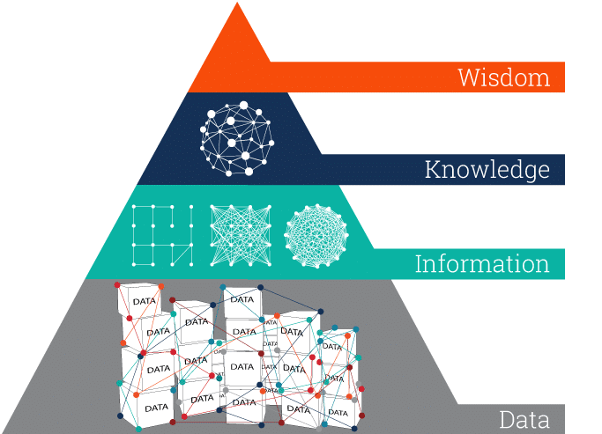
DIKW Pyramid >>
Notes:
1.1. The pyramid is a representation of the relationships between data, information, knowledge and wisdom
1.2. Each step up the pyramid answers questions about the initial data and adds value to it. The more questions we answer, the higher we move up the pyramid. In other words, the more we enrich our data with meaning and context, the more knowledge and insights we get out of it.
1.2.1. Data: Data is a collection of ‘facts’ (something verifiable) in a raw or unorganized form such as numbers or characters. The ‘facts’ may be in alpa-numeric form but they are unprocessed or unorganised and therefore meaningless since we cannot comprehend (make sense) of it.
1.2.2. Information:
Arises when we describe the data
Information emerges when we process, organise and structure the data
(Typical shape, value, variation, in a way that exposes relationships between various seemingly disparate and disconnected data points).
Structured data = information
1.2.3. Knowledge:
• Arises when we ask “How” is the information – derived from the collected data – relevant to our (research) goals?
• And, maybe most importantly, “how” can we apply the information to achieve our goal?
• “How” are the pieces of this information connected to other pieces to add more meaning and value? When we don’t just view information as a description of collected facts, but also understand how to apply it to achieve our goals, we turn it into knowledge.
• Answering the above infuses information with relevance (tied for a specific purpose or context), and is therefore meaningful (w.r.t. a goal).
1.2.4. Wisdom:
• Judgement about and ‘what is best’ appropriate or right thing to do.
• In other words, wisdom is knowledge applied in action.
Source: https://www.ontotext.com/knowledgehub/fundamentals/dikw-pyramid/

Slide 3
Primary
Data Sources
Secondary
Tertiary
Notes:
There are three conventional categories of sources of data: primary, secondary, and tertiary. (Booth et al., 2016; p. 65)

Slide 4
2. Sources of Data >>
Threefold classification of the Sources of data
Primary source: first-hand accounts that have not been edited, interpreted or
evaluated in any way that might change the original information
Secondary source: is created when we do something to a primary source such as: examine it, evaluate it, critique it, interpret it, or reflect on it in order to reuse that information for another purpose.
Tertiary source: Emerges when one creates indexes, abstracts, organizes, compiles, or digests primary and secondary sources into a textual consolidation.
Notes:
The threefold classification of sources of data
Primary sources: first hand accounts that have not been edited interpreted or evaluated in any way that might change the original information.
Secondary sources: A secondary source arises when we do something to a primary source such as: examine it, evaluate it, critique it, interpret it, reflect on it in order to reuse that information for another purpose.
Tertiary sources: A source which indexes, abstracts, organizes, compiles, or digests primary and secondary sources about a topic into a textual consolidation.

Slide 5
3. Primary sources >>
What are primary sources?
First hand accounts of a phenomenon or event.
Contain original, raw or unprocessed data.
How are primary sources created?
Created by witnesses or recorders who experienced the events or conditions and documented it.
Notes:
What are they? These sources provide a first-hand account of an event. They contain the original, raw or unprocessed data. Are considered authoritative sources since they are closest ot the original source (compared to persuasive sources as in the case of secondary sources)
How are they created? They are created by witnesses or recorders who experienced the events or conditions that were documented.
Note: A. Primary data sources undoubtedly constitute the purest form of data-these sources are first-hand and unfiltered. As such, primary data sources may be the preferred choice in many types of research, particularly those pertaining to scholarship, where credibility might be questioned if only secondary data sources were used.
[1] What is a Primary Source? - Library Research Guide for the History of Science: Introduction - Research Guides at Harvard Library

Slide 6
3. Primary sources >>
Examples of primary sources?
Original documents: Lab recordings, instrument measurements, diaries, speeches, manuscripts, letters, interviews, news film footage, contemporary newspaper articles, autobiographies, official records, pamphlets, meeting notes, photographs and contemporary sketches.
Creative works: Poetry, drama, novels, music, art
Relics or artifacts: Furniture, clothing, buildings
Advantages & Disadvantages
Pros: purest form of data, first hand accounts, contains richness in detail.
Cons: can contain biases, difficult/expensive to obtain; could be fragile (e.g. old manuscripts).
Notes:
Examples of Primary sources include:
Original documents (excerpts or translations acceptable): Observations of laboratory experiments, sensor/instrument readings, diaries, speeches, manuscripts, letters, interviews, news film footage, contemporary newspaper articles, autobiographies, official records, pamphlets, meeting notes, photographs and contemporary sketches.
Creative works: Poetry, drama, novels, music, art
Relics or artifacts: Furniture, clothing, buildings.
Note 1: Often these sources are created at the time when the events or conditions are occurring, but primary sources can also include autobiographies, memoirs, and oral histories recorded later.
Note 2: Primary sources are characterized by their content, regardless of the format available. (Handwritten notes could be photocopied; the published book might be digitized or put on microfilm, readings from sensors could be entered into a spreadsheet, but they are all still primary sources in any format).
1. Advantages and Disadvantages:
Pros: they are first-hand accounts. The rawest form of data contains the perspective of the people who created them and contains rich details.
Cons: Can contain biases, difficult/expensive to obtain, could be fragile (in case of old manuscripts).

Slide 7
4. Secondary sources >>
What are secondary sources?
Provides a distilled (summarises) and interpreted view of primary sources.
How are secondary sources created?
Created by analysing, interpreting and synthesising primary sources.
Secondary, since it is a degree removed from a primary source..
Notes:
Secondary sources
What are they? These sources provide a distilled (i.e. a summary) and interpreted view of primary sources. Considered persuasive (rather than authoritative).
How are they created? Created by analysing, interpreting and sysnthesising of primary sources. Considered secondary since it is a degree removed from the primary source.

Slide 8
4. Secondary sources >>
Examples of secondary sources?
Books, Journals articles, Documentaries, Biographies, Literary criticism and Industry reports.
Advantages and Disadvantages of secondary sources
Pros
Convenience
Contains interpretation and synthesis
Time saving.
Cons
Distance removed so contextual information and richness of details omitted.
Interpretation: may contain biases, inaccuracies and misinterpretations.
Notes:
Examples include:
Books, journal articles,
Advantages and disadvantages:
Pros
Convenient; Are widely available and hence easy to access and use.
Interpretation and synthesis: which help quickly understand a topic or key take-away.
Time-saving: experts in the field have summarised and interpreted the material.
Cons:
Distance from the source means that contextual details may be removed.
Since it is interpreted may contain biases, inaccuracies and misinterpretations.

Slide 9
5. Tertiary sources >>
What are tertiary sources?
Provides a general overview of a topic from a combination of primary and secondary sources.
How are tertiary sources created?
Created by summarising and repackaging key ideas/themes related to a topic.
Tertiary, since it is two degrees removed from a primary source.
Notes:
Tertiary sources
1. What are they? These sources provide a general overview of a topic from a combination of primary and secondary sources.
2. How are they created? Created by producing compilations or digests about a topic by synthesizing primary and secondary sources on the same. Considered tertiary since it is two degrees removed from a primary source.

Slide 10
5. Tertiary sources >>
Examples of tertiary sources?
Indexes of a topic, abstracts, encyclopedias, digests and text books.
Advantages and disadvantages of tertiary sources
Pros
Provides an overview without the details.
Starting point or citations to secondary sources.
Related topics and keywords.
Cons
Does not present new information or new analysis.
Notes:
Tertiary sources
Examples: itext books, encyclopaedias, mass circulation publications
Advantages and disadvantages:
Pros:
Useful when one is just starting out on a new topic since it can provide a quick overview of the subject without getting too in-depth into details.
Good starting point to identify broad ideas/themes debates/problems in the field.
Useful to find key ideas and sources of key secondary sources.
Some entries contain entries such as ‘Related topics’ and ‘keywords’ which help one to find more information on a topic.
Cons:
Does not present any new information or new analysis of information.

Slide 11
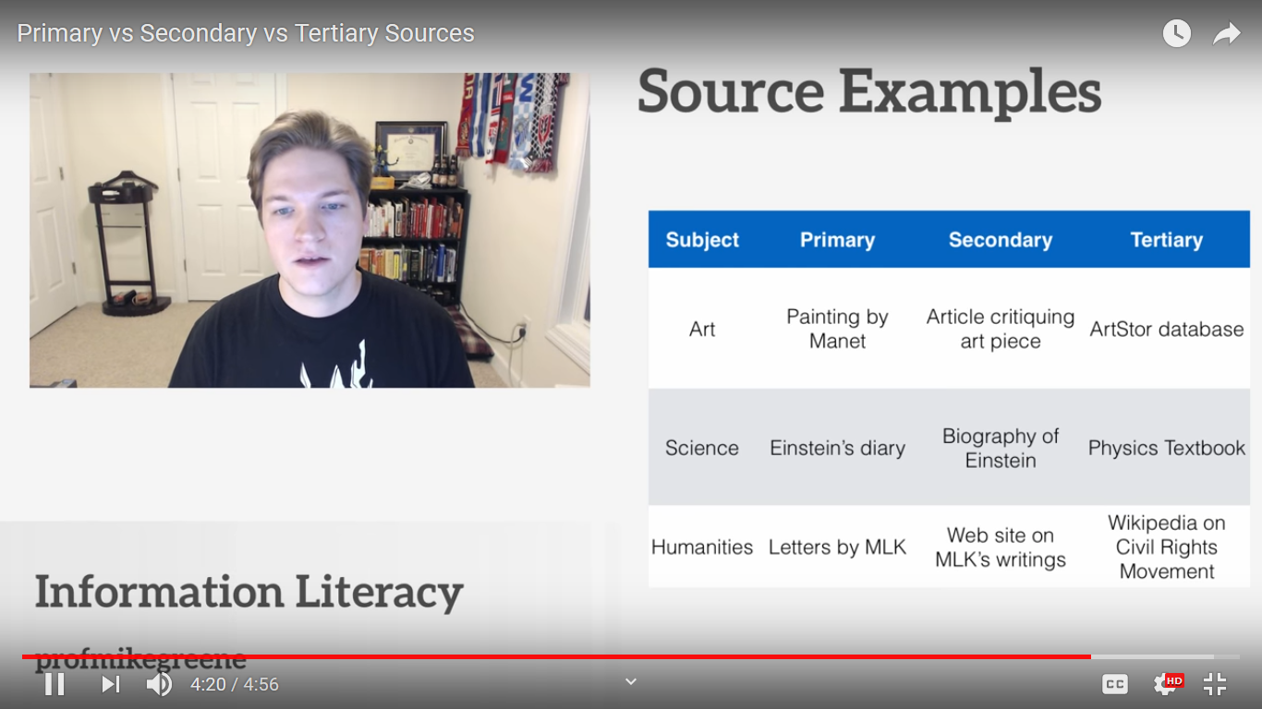
6. Comparison of sources >>
Types of Methods: According to types of data
Notes:
The following image shows the distinction between primary secondary and tertiary sources in the academic faculties of art, science and humanities.

Slide 12
7. Using the various sources of information >>
Starting points
Tertiary - secondary - primary.
Building context to your research
Secondary sources: locates one's study within existing research.
Tertiary sources: identifies key ideas/themes and texts around a topic.
Notes:
When starting out on a new topic it is best to move from tertiary to secondary and only then on to primary sources (if your research requires this).
Primary sources/data which considered the purest more often just stands alone (a collection of facts about some specific event or local phenomenon). In order to demonstrate its position with existing research it is necessary to consult secondary sources in order to contextualize primary sources.

Slide 13
Class exercise >>
Recall
The research problem your group is working on
The research questions you are asking
Describe the primary, secondary and tertiary sources you would consult
Mention sequences of sources.
Along with justification.

Slide 14
B) Bibliographical and Empirical sources
1) Bibliographical source
Involves literature-based reading and thinking.
Documents (literature, photographs, videos and works of art) are the foundation to gather data.
Most research begins with an attempt to understand others’ investigations as they appear in the relevant literature using bibliographical sources are often considered secondary and tertiary sources.
However bibliographical sources are not essentially secondary (and tertiary) sources alone.

Slide 15
Bibliographical sources
Primary bibliographical sources:
This is an original document that contains first-hand information about a topic or an event such as:
Historical documents (letters, pamphlets, political tracts, manifestos)
Data and Research Results (scientific article presenting original findings, statistics)
Original works of art
Video footage & photographs
Works of literature
Interview transcripts
Eyewitness accounts, newspapers articles & autobiographies
Blogs articles, tweets and other social media entries
Lab notebooks and case studies

Slide 16
2. Sources of Data >>
Secondary bibliographical sources:
An interpretation, analysis, discussion or evaluation of an event or issue that is based on primary source evidence.
Biographies
Indexes, Abstracts, Bibliographies
Journal articles
Literary criticism
Monographs written about the topic
Reviews of books, movies, musical recordings, and works of art.
Newsletters and professional news sources

Slide 17
B) Bibliographical and Empirical sources
2) Empirical source
Experience serves as the foundation of data.
Broadly this involves observation
Mostly used to extend research (after a review of past research) by gathering original data.

Slide 18
Academic writing
Identification of research problem
Literature review and gaps
Identify possible data sources- primary/secondary/tertiary
1. Where to look for the data?
2. How to choose?
3. How to collect

Slide 19
Unit of Analysis or Research Unit
The subject (the who or what) of study about which a researcher may generalise
E.q. schools, institute, communities, interest groups, voters etc.
Notes:
Ref. Long (2011). "Unit Of Analysis” in The SAGE Encyclopedia of Social Science Research Methods

Slide 20
Accessing Participants: Sampling in Primary Data Source
Selection process used for identifying possible research unit /unit of analysis
Notes:
Ref. Foundation of Behavioural Research, Fred N Karlinger, 1986, 3rd ed.

Slide 21
Universe
Everything (individuals, objects, events etc.) that have a designated set of specifications that a research/ study aims to pursue
Notes:
Ref. Foundation of Behavioural Research, Fred N Karlinger, 1986, 3rd ed.

Slide 22
Population
Well-defined group of people, objects, etc.
The population must be defined explicitly before a sample is taken
Notes:
Ref. Foundation of Behavioural Research, Fred N Karlinger, 1986, 3rd ed.

Slide 23
Why we need sampling?
To select unit of research
To generalize results to a population
Obviously we can’t go to everyone and ask
Notes:
Ref. Foundation of Behavioural Research, Fred N Karlinger, 1986, 3rd ed.

Slide 24
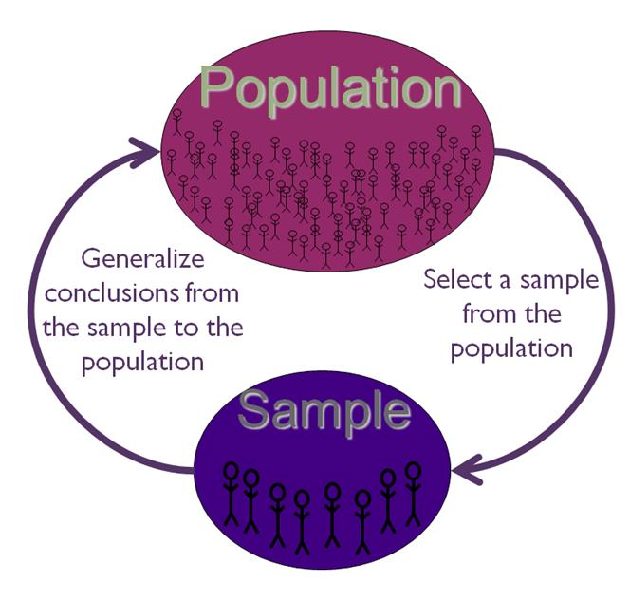
Notes:
Ref. Foundation of Behavioural Research, Fred N Karlinger, 1986, 3rd ed.
The figure depicts that we select ‘sample’ from the population for the study. Then, we generalise the findings obtained from the sample to the population. For example: if a researcher wants to study preference of phone brands amongst first year engineering students in Goa. So, our population is all the 1st year engineering students across colleges in Goa. The sample would be drawn from the population. After conducting the study the researcher would conclude that x% first years like Y brand etc.

Slide 25
Sample
Sample
A group/ segment/ portion of the population (people/objects etc.)
Representative sample
A sample that represents the characteristics of a population accurately
Notes:
Ref. Foundation of Behavioural Research, Fred N Karlinger, 1986, 3rd ed.

Slide 26
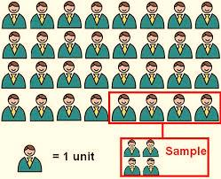

Slide 27
Sampling Frame
All the units in the population from which the sample will be selected
Examples
Telephone directory
Elementary schools
University students, faculties
Members of a club
Social service organizations
Political party
Census data
Notes:
Ref. Foundation of Behavioural Research, Fred N Karlinger, 1986, 3rd ed.

Slide 28
Sample Size
Number of the individuals/ objects/ units
Statistically derived from the population in case of quantitative research
Not predetermined for qualitative research
Notes:
Ref. Foundation of Behavioural Research, Fred N Karlinger, 1986, 3rd ed.

Slide 29
Academic writing
Identification of research problem
Literature review and gaps
Identify possible data sources- primary/secondary/tertiary
1. Where to look for the data?
2. How to choose?
3. How to collect

Slide 30
Sample
Universe
Population
Sample
Target Population
Study population
Sampling frame
Sample
Notes:
Ref. Foundation of Behavioural Research, Fred N Karlinger, 1986, 3rd ed.

Slide 31
Sampling
The process of using small number of items from the population in order to make conclusions for the entire population
Its useful over studying the entire population as it is
more practical
less time consuming
economically viable

Slide 32
Types of Sampling
Probability Sampling
Non-Probability sampling
Simple Random Sampling
Stratified Random Sampling
Cluster sampling
Quota sampling
Convenience sampling
Purposive sampling
Snowball sampling
Opportunistic sampling
Notes:
Ref. Foundation of Behavioural Research, Fred N Karlinger, 1986, 3rd ed.
Broadly, sampling can be divided into two types: Probability sampling and non-probability sampling.
A. Probability Sampling: It specify the probability/ Likelihood of inclusion of each element/unit in the sample.
Conditions: The Size of Universe (ex. Indian Population) should be known to the researcher; The desired sample size should be clearly specified; Where every unit of the sample frame has the EQUAL CHANCE of getting selected.
A.1. Randomness: All elements in a given population have an equal and independent chance of being included in the sample
A.2. Method: Fishbowl draw method, Table of Random numbers; Computer-generated random numbers
A.3. Random sampling: Random sampling is a type of probability sampling where everyone in the entire target population has an equal chance of being selected. This is similar to the national lottery. If the “population” is everyone who has bought a lottery ticket, then each person has an equal chance of winning the lottery (assuming they all have one ticket each). Random samples require a way of naming or numbering the target population and then using some type of raffle method to choose those to make up the sample. Random samples are the best method of selecting your sample from the population of interest. The advantages are that your sample should represent the target population and eliminate sampling bias, but the disadvantage is that it is very difficult to achieve (i.e. time, effort and money).
A.4. Simple Random Sampling: Unrestricted random sample; All individuals in the population have an equal likelihood of being chosen; Not feasible; Some times it is not accurate
A.5. Systematic Random Sampling: Used when a fixed percentage of the population are to be selected; The starting point is randomly selected to avoid biasness; Next selection would be based on every n^{th} individual (n= is referred to as the sampling interval). Empirically ,the results are identical with Simple random sampling; Slightly more accurate than Simple random sampling. Laborious if done manually; If any list of elements are arranged in a cyclical pattern that coincide with the sampling interval, the sample become biased.
A.6. Stratified Random Sampling: The population is divided into STRATA or Groups based on a single criterion/ two; Random selection of units from each strata or groups; Two types of stratified sampling; Proportionate Stratified Random Sampling: The population characteristics are known to the researcher; Randomly draws sample in a similar proportion of the each stratum. Dis-proportionate Stratified Random Sampling: The substrata from the drawn sample are not necessarily proportional; Sometimes some substrata are overrepresented or some underrepresented.
A.7. Cluster Sampling: Also known as Area sampling; Roots in Agriculture; Use in Survey and Field based research; Total population is divided into different clusters based on Geographical territory, Community, Neighbourhood, Cities, States etc. after clustering Random sampling is conducted.
Example: To explore the attitude of people of Bengaluru on the present condition of traffic: First, we will get a Map of Bengaluru. Then, identify Divisions based on area, Next, we can take Help from a random numbers table/ computer; Finally, we will draw a specified number of sections to constitute the study population.
Disadvantages: Degree of sampling error is high; There is no exact method to ensure that each sample unit included in an area sample will be of equal size; What if an individual who was included in one cluster travels to the another randomly selected cluster?
B. Non-Probability Sampling: When the researcher cannot estimate the probability of selection of each member of a population being included in the sample.
B.1. Quota Sampling: Similar to stratified sampling except the researcher chooses the sample from each stratum based on his/her prior knowledge/ not by random sampling technique.
B.2. Convenience sampling: Sample selection based on convenience (Accessibility, Availability, and Feasibility)
B.3. Purposive Sampling: Also known as Judgmental sampling. Specific inclusion criteria based on the purpose of the research. The samples are thought to be the Typical of the population.
B.4. Snowball sampling: All the persons in a group identified their friends who in turn identify their friends and associates until the researcher observes that a constellation of friendships converges into some definite social pattern. It is a sociometric sampling technique. Generally used to see the social change or to observe diffusion/ circulation of information in some organization. Used mostly in case of sensitive topics. Used when N is expected to be <100
Examples: Drug addiction and music preference or attitude towards LGBT community.
B.5. Opportunistic sampling: Same as convenience sampling. After data collection starts becomes purposeful sampling. Based on unfolding events

Slide 33
Probability sampling
Probability sampling (or representative sampling) is most commonly associated with survey-based research strategies (helps you to make inferences)
Major steps:
Identify a suitable sampling frame based on your research question(s) or objectives.
Decide on a suitable sample size.
Select the most appropriate sampling technique and select the sample.
Check that the sample is representative of the population

Slide 34
Probability sampling types
Simple Random sampling- involves you selecting the sample at random from the sampling frame using either random number tables , a computer or an online random number generator, such as Research Randomizer (2008)

Slide 35
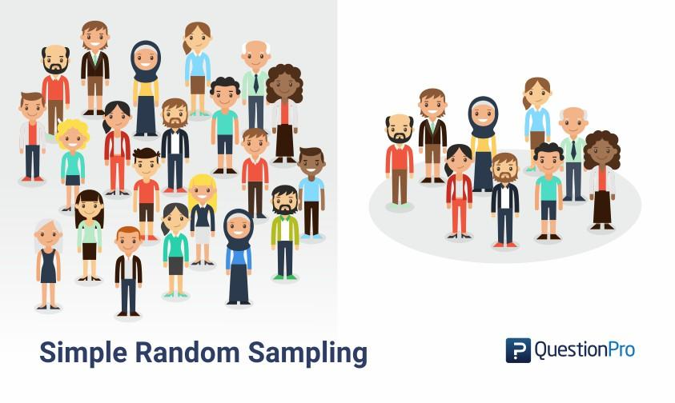
Simple Random Sampling

Slide 36
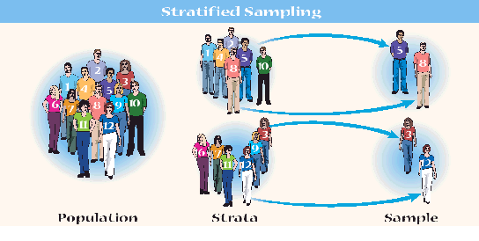

Slide 37
Probability sampling types
Stratified sampling- where you divide the population into two or more relevant and significant strata based on one or a number of attributes.
The sampling frame is divided into a number of subsets.
A random sample (simple or systematic) is then drawn from each of the strata.

Slide 38
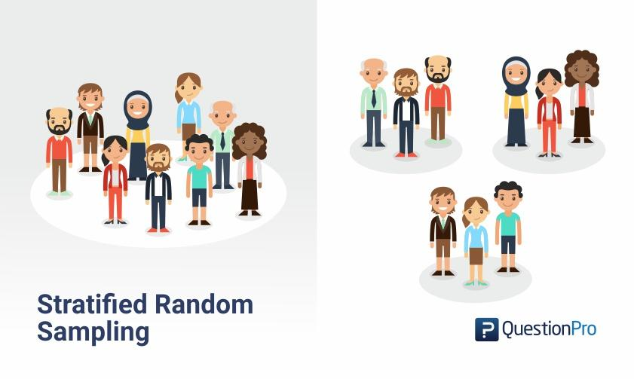

Slide 39
Probability sampling types
Cluster sampling- population is divided into discrete groups before sampling, called clusters
These are based on any naturally occurring grouping

Slide 40
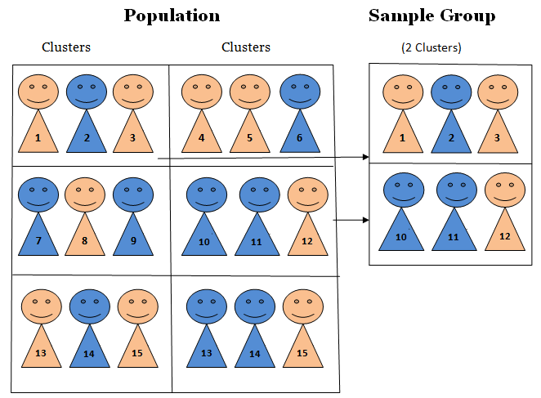
Cluster Sampling

Slide 41
Non- Probability sampling
Nonprobability sampling (or non-random sampling) provides a range of alternative techniques to select samples based on your subjective judgment

Slide 42
Non-probability sampling types
Quota sampling is a type of stratified sample in which selection of cases within strata is entirely non-random (Barnett 1991)
It is normally used for interview surveys

Slide 43
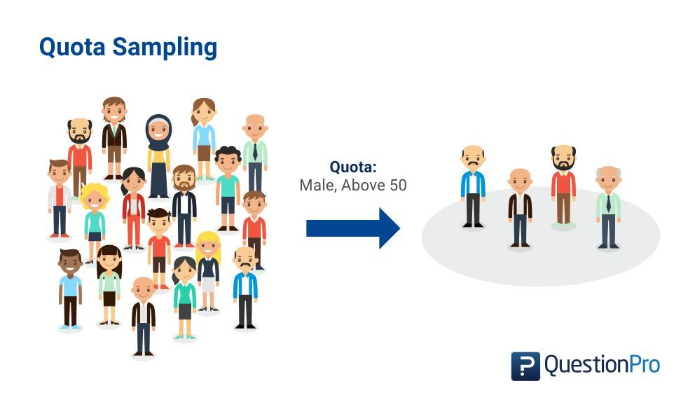

Slide 44
Non-probability sampling types
Purposive sampling- enables you to use your judgment to select cases that will best enable you to answer your research question(s) and to meet your objectives
This is often used when working with very small samples such as in case study research

Slide 45
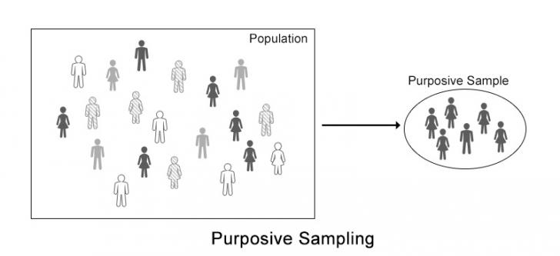

Slide 46
Non-probability sampling types
Snowball sampling- in which subsequent respondents are obtained from information provided by initial respondents

Slide 47

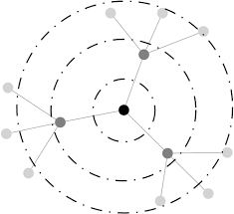
Snowball Sampling

Slide 48
Non-probability sampling types
Convenience Sampling- involves selecting haphazardly those cases that are easiest to obtain for your sample

Slide 49


Slide 50
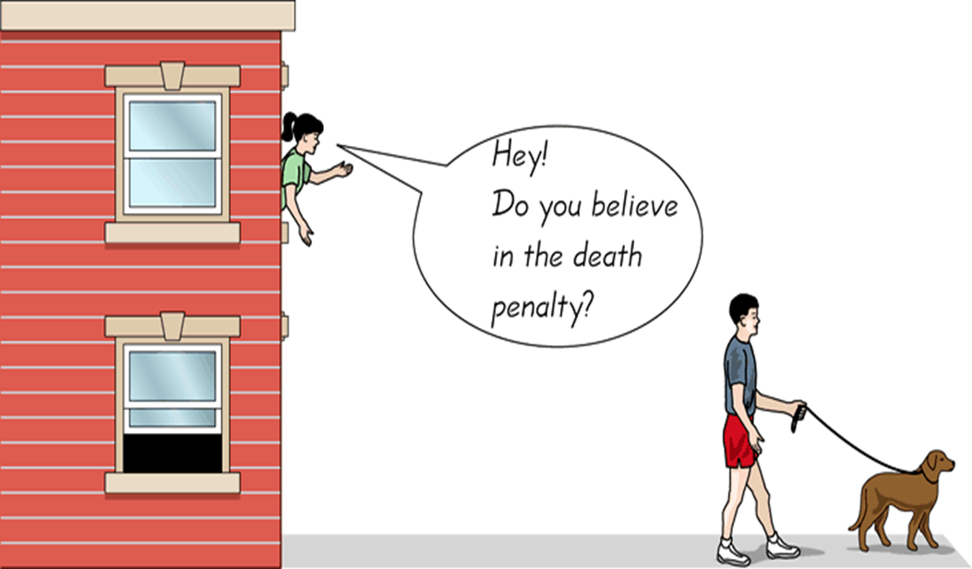
Opportunistic Sampling

Slide 51
Academic writing
Identification of research problem
Literature review and gaps
Identify possible data sources- primary/secondary/tertiary
1. Where to look for the data?
2. How to choose?
3. How to collect?

Slide 52
IN SUMMARY THE STEPS FOR SAMPLING
Defining the Target Population
Determining the Sampling Frame
Select A Sampling Technique(s)
Determine the Sampling Size
Execution of Sampling Process

Slide 53
Study Context
Geographical
Social
Psychological
Political
Notes:
Ref. Foundation of Behavioural Research, Fred N Karlinger, 1986, 3rd ed.

Slide 54
Methods of Data Collection
Data Source Type | Mode of Data collection
Primary | Direct
Secondary | Indirect
Tertiary | Indirect

Slide 55
Types of Data Collection Tools
Type of Data Source | Tools
Primary | Experiments Observation (Participatory & Non-participatory) Interviews (face-to-face, focus group) Surveys
Secondary | Review Systematic review, etc.
Notes:
Ref. Foundation of Behavioural Research, Fred N Karlinger, 1986, 3rd ed.

Slide 56
4. Methods of Data Collection
Experiments
Prime method of inquiry in natural sciences and social sciences like psychology
Key features:
Motivation: to establish cause and effect relationships
An investigation in which a hypothesis about cause and effect is scientifically tested.
An independent variable (the cause) is manipulated
The dependent variable (the effect) is measured
Extraneous/Peripheral variables are controlled
Control procedure

Slide 57
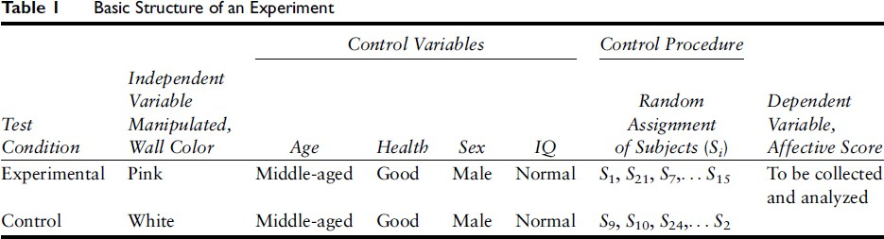
4. Methods of Data Collection >>

Slide 58
Observation
Systematically observing and documenting behaviors, events, or phenomena to gather data
Used to obtain real-time information about subjects under study
Steps involved-
defining objectives
determining variables
identifying the setting
developing the observation protocol
observation and recording
recording and analysing
Notes:
defining objectives- defining the purpose and goal of the project
determining variables-Identify the key variables or behaviors to observe
identifying the setting-based on accessibility, relevance and ethical consideration identify the appropriate site for conducting observation
developing the observation protocol- planning for the observation to define the procedure, criteria and the guideline for observation and recording
observation and recording- conducting the observation and recording the data
analysing

Slide 59
Types of observation
Controlled observation- observation conducted within a defined setting like a lab
Naturalistic observation- observation conducted in the natural setting
Participant observation- participation of the observer/researcher in the setting

Slide 60
Interview
Decide the duration of the interview
Decide the number of questions accordingly
Adequate focus on the topic
Think about sequence
Ask intelligent and smart questions

Slide 61
Advantages & Disadvantages
Advantages-
Provides qualitative data
Enables you to observe the reactions of the respondent
Disadvantages-
Time consuming
Cannot contact large number of people

Slide 62
Telephonic Interviews
Advantages
Quickest of the survey techniques
Easy access
Cost is low
Disadvantages
Detailed data cannot be gathered
Cannot observe body language
Lack of privacy

Slide 63
Development of Tools: Survey questionnaire
Interaction or conversation with a purpose
Effective method for collecting primary information
Purpose of collecting data – data collection interviews
Face -to-face or telephonic

Slide 64
Preparing Questions
Data Collection Interviews
Personal interviews
Subjective – attitudes – preferences – opinions – tastes – emotional reactions
Determine facts known to a single individual or a group of people

Slide 65
Preparing Questions
Open-ended questions – respondent can offer an opinion – not just an yes or no
“What is your role in bringing back normalcy among employees?
Close –ended questions – gives specific information
“ Do you feel the unrest among employees will continue for a week?”
Restatement question – based on the respondent’s previous answer
“ You said that the union leader would be meeting the employees this evening. Is that information correct?”

Slide 66
Double-barreled questions
Do you think students should have more classes in Technical Report Writing and Biology?
Would you like to go for a menu which is spicy and colourful?
Do you prefer a grading system that is more liberal and with more division of grades?
Do you feel this shop has variety and quality in its selling products?

Slide 67
Questionnaires
To collect data from a large number of people
To secure information ,facts, opinions, and attitudes
Examples:
What is your opinion on establishing a gymnasium in our campus? (open ended)
What do you feel about the availability of space for gym adequate/inadequate?(dichotomous close ended)

Slide 68
Example
Multiple choice
What are the time slots do you feel would be appropriate for the new gymnasium?
a. 5.30 - 6.30 a.m
b. 6.00 – 7.00 a.m
c. 5.00 – 6.00 p.m
d. 6.30 – 7.30 p.m.

Slide 69
Preparatory Steps
Provide clear instructions
Keep the questionnaire short
Sequencing - ask about only one aspect at a time
Pretest the questionnaire

Slide 70
Ethical Consideration
Informed consent should be collected from the participants
All the required permission should be obtained
Participants’ identity should be kept confidential
Objectives and purpose of the study should be explained to the participants
All participants should be given choice of withdrawing from the study at any point of time

Slide 71
References
Kerlinger, F N. (1986).Foundations of Behvaioral Research (3rd edition). Chicago: Holt, Rinehart and Winston, Inc.
Long, K J. (2011). Unit Of Analysis in Lewis-Beck, M. S., Bryman, A., & Futing Liao, T. edited The SAGE encyclopedia of social science research methods Thousand Oaks, CA: Sage Publications, Inc. doi: 10.4135/9781412950589
Malhotra, N K. & Das, S. (2017). Marketing Research: An Applied Oriantation (7th edition). India: Pearson
McGinn, M K (2012). Secondary Data in Given, L. M. he SAGE encyclopedia of qualitative research methods (Vols. 1-0). Thousand Oaks, CA: SAGE Publications, Inc. doi: 10.4135/9781412963909
Persaud, N. (2012). Primary Data Source. In Salkind, N. J. edited Encyclopedia of research design. Thousand Oaks, CA: SAGE Publications, Inc. doi: 10.4135/9781412961288

